Slide 1

BIOMEDICAL FORENSICS (VIRTUAL)
EG1003 | LAB 11

Slide 2
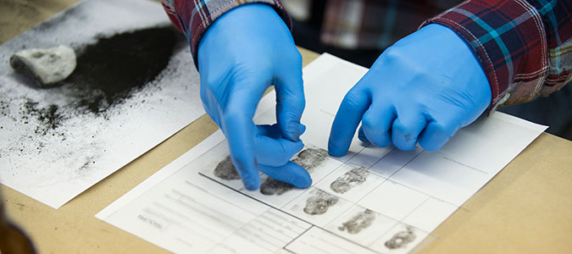
OBJECTIVE
Use basic forensic techniques
DNA extraction
Fingerprinting
Drug testing
Blood typing
Solve a murder mystery
Figure 2: Fingerprinting Courtesy of Marian University
2

Slide 3
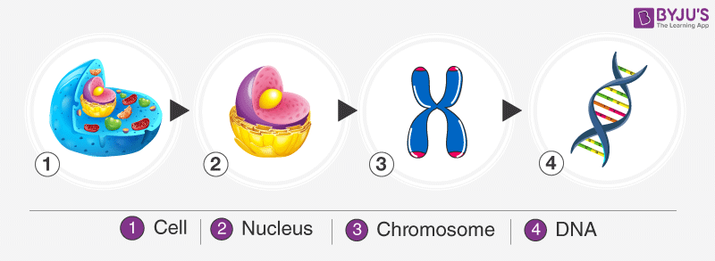
BACKGROUND INFORMATION
Deoxyribonucleic acid (DNA)
Packaged in the form of chromatin (which make up chromosomes)
Exist in the nuclei of cells
Plant cells have a cell wall that must be penetrated to access the DNA
Figure 3: DNA Packaging Sequence Courtesy of Byju’s
3

Slide 4
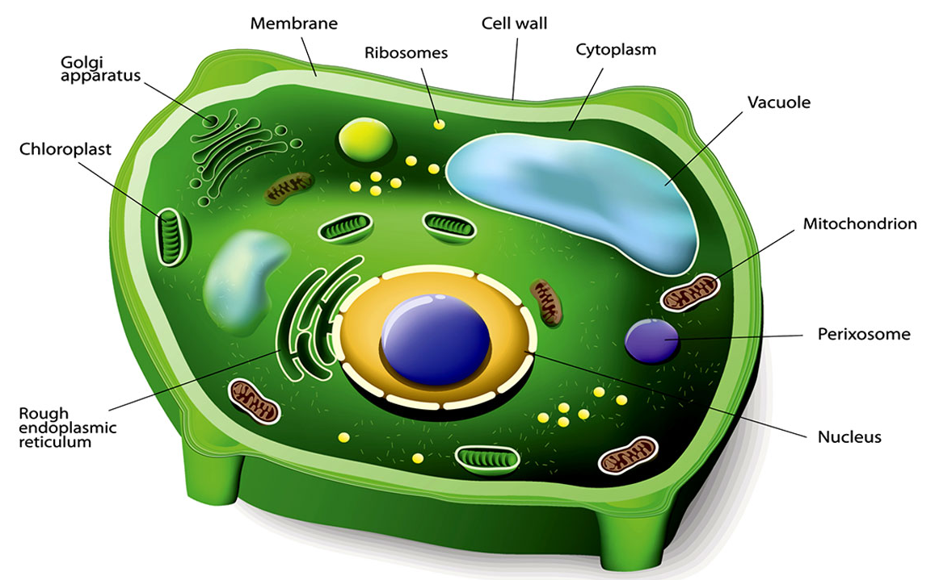
BACKGROUND INFORMATION
DNA extraction (of a plant cell)
Break the cell wall (cell lysis) to expose the DNA within the cell
Destroy the plasma membrane to further expose the DNA
Precipitate the DNA to make the DNA visible
Figure 4: Plant Cell Structure Courtesy of Biology Wise
4

Slide 5
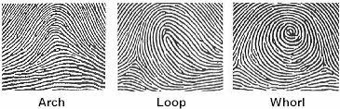
BACKGROUND INFORMATION
Fingerprints – unique patterns consisting of friction ridges and burrows
Loops – 60% of pattern types
Whorls – 35% of pattern types
Arches – 5% of pattern types
Figure 5: Fingerprint Types Courtesy of Headlines on Human Hands
5

Slide 6
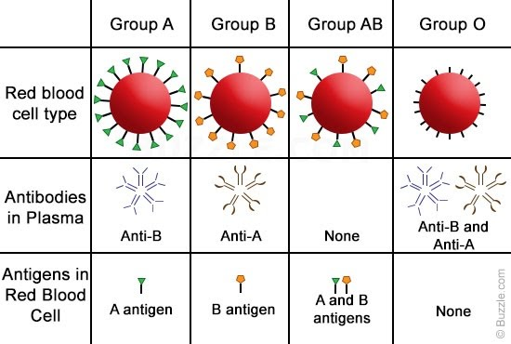
BACKGROUND INFORMATION
Blood typing (ABO system)
Existence of antigens on red blood cells determine blood type
A and B antigens determine type of blood (A, B, AB, or O)
Rh antigen determines presence of Rhesus factor (indicated by +/-)
Figure 6: ABO Blood Type System Courtesy of Buzzle.com
6

Slide 7

MATERIALS
Computer with internet access
Paper
Pencil with graphite
Clear packaging tape
7

Slide 8

PROCEDURE
Follow the videos and procedure to learn biomedical forensic techniques
Forensic Academy:
DNA extraction
Fingerprinting
Drug testing
8

Slide 9

PROCEDURE
Solve a murder mystery
Crime Scene Investigation:
Drug testing
Blood typing
Fingerprinting
Compare data to the Suspect Information Sheet
Determine who is the killer
9

Slide 10
ASSIGNMENT
Team lab report:
Answer discussion questions in manual
Include screenshots of extracted DNA, fingerprint on murder weapon, blood typing of suspects, and drug present in victim’s blood
Include the fingerprint and blood type of the killer
Due at 11:59 PM the night before next lab session
Team presentation:
Address discussion points in manual
Rely heavily on graphics and pictures
10

Slide 11
CLOSING
Take screenshots of the extracted DNA, fingerprints, blood typing, and drug present in victim’s blood
Record data in the Suspect Information Sheet
Tell a TA who you think the killer is before leaving lab
Submit all work electronically
11

Slide 12
QUESTIONS?

